Slide 1
NICKABLE SLIDES
December 2020

Slide 2
It’s been a boom year for digital content consumption
TOTAL TIME FOR TOTAL AUDIENCE OF TOP 150 TAGGED DIGITAL CONTENT BRANDS
Total time spent on top 150 digital content brands up 19% YoY to date.
Peak month March 2020 up 28% YoY
Source; Nielsen Digital Content Ratings Monthly Tagged, January 2019 – November 2020, P2+, Digital c/m, Test, Top 150 brands, Total Time Spent

Slide 3
53% of online time is spent consuming content and 47% using internet tools
SHARE OF INTERNET TIME BY ACTIVITY
GROWTH IN TIME SPENT USING INTERNET TOOLS:
Email
Instant Messaging
Source; Nielsen Digital Panel , text, average total time 12 months to August 2020 versus 12 month to August 2019, PC P2+, Smartphone and P18+

Slide 4
59% of online time spent consuming content is spent on entertainment
SHARE OF ONLINE CONTENT TIME SPENT
(BREAKDOWN OF 53% OF TOTAL ONLINE TIME SPENT ON CONTENT)
GROWTH IN TIME SPENT CONSUMING CONTENT:
News
Financial news, insurance, online trading
Health, Fitness, Nutrition
Music
Major retailers
Food & cooking
Home and garden
Educational resources
Kids, games, toys
Pets and animal care
Source; Nielsen Digital Panel , text, average total time 12 months to August 2020 versus 12 month to August 2019, PC P2+, Smartphone and P18+

Slide 5
Australians continue to access online content daily across multiple screens
MOBILE
17.0 million
DESKTOP
8.6 million PC
3.0 million MAC
CONNECTED TV
7.1 million
TABLET
4.3 million iPad
1.4 million Android
Average 6.7 video capable screens per household
Source; IAB Australia Nielsen Digital Enumeration Study Jul 20 – Sep 20 quarter ages 14+ n=3000 per quarter; ThinkTV TV Fact Pack Tech Penetration H1 2020

Slide 6
Audience for Connected TV is growing strongly
VIEW INTERNET CONTENT ON A CONNECTED TV DAILY
10.6 million Australians have ever viewed Internet content on a TV screen, 7 million daily.
25% YoY increase
Source; IAB Australia Nielsen Digital Enumeration Study Jul 20 – Sep 20 quarter ages 14+ n=3000 per quarter

Slide 7
Smart speaker ownership is emerging, with 19% of Australians owning this device
% WITH A SMART SPEAKER AT HOME
4 million Australians own a Smart Speaker.
Of these, 32% use it daily and 58% at least weekly.
Source; IAB Australia Nielsen Digital Enumeration Study July 20 – September 20 quarter ages 14+ n=3000 per quarter

Slide 8
Usage of Smart Speaker is growing
USES OF SMART SPEAKER
(AMONGST THOSE USED A SMART SPEAKER IN LAST MONTH)
2.7 million Australians used Smart speaker in last month, 38% growth in usage year on year.
Increased usage driven by –
Listening to podcasts +71%
Controlling devices +61%
Listening to radio +52%
Streaming music +46%
Source; IAB Australia Nielsen Digital Enumeration July 20 – September 20 quarter ages 14+ n=3000 per quarter

Slide 9
Digital news content engagement heightened this year from bushfires to COVID-19 to US politics
TOTAL TIME SPENT FOR TOTAL AUDIENCE IN NEWS CATEGORY
(TAGGED CONTENT)
Peak month March 2020 up 77% YoY
Total time spent on digital news content up 46% YoY to date.
Source; Nielsen Digital Content Ratings Monthly Tagged, January 2019 – November 2020, P2+, Digital c/m, Test, Current Events and Global News Category , Total Time Spent

Slide 10
Consumers sought financial information and kept a close eye on the share market
TOTAL TIME SPENT FOR TOTAL AUDIENCE IN FINANCE AND BUSINESS NEWS CATEGORY
(TAGGED CONTENT)
TOTAL TIME SPENT FOR TOTAL AUDIENCE IN ONLINE TRADING CATEGORY
Peak month March 2020 up 69% YoY
Peak month June 2020 up 29% YoY
Source; Nielsen Digital Content Ratings Monthly Tagged, January 2019 – November 2020, P2+, Digital c/m, Test, Current Events and Global News Category , Total Time Spent
Source; Nielsen Digital Panel text PC age 2+, Smartphone & Tablet age 18+ (total time spent YOY January to August 2019 v 2020)

Slide 11
Interest in real estate rebounded in May, with October seasonal peak up 30% on last year
TOTAL TIME SPENT FOR TOTAL AUDIENCE IN REAL ESTATE CATEGORY
(TAGGED CONTENT)
Total time spent on digital real estate up 27% YoY to date.
Peak month October 2020 up 30% YoY
Source; Nielsen Digital Content Ratings Monthly Tagged, January 2019 – November 2020, P2+, Digital c/m, Test, Real Estate Category , Total Time Spent

Slide 12
Behavioral shift from COVID-19 lockdown driving up time spent with major retailers online
TOTAL TIME SPENT FOR TOTAL AUDIENCE IN MAJOR RETAILERS CATEGORY
Total time spent on major retail sites and apps up 19% year on year to date.
Peak month April 2020 up 44% YoY
Source; Nielsen Digital Panel text PC age 2+, Smartphone & Tablet age 18+ (total time spent YOY January to August 2019 v 2020)

Slide 13
Lift in consumption of lifestyle, food, home, health and family content during COVID-19 lockdown
TOTAL TIME SPENT FOR TOTAL AUDIENCE IN LIFESTYLE CATEGORY
(TAGGED CONTENT)
Total time spent on digital lifestyle content up 24% YoY to date.
Peak month March 2020 up 103% YoY
Source; Nielsen Digital Content Ratings Monthly Tagged, January 2019 – October 2020, P2+, Digital c/m, Test, Total Time Spent Apparel/Beauty ,Family & Lifestyles ,Family Resources ,Food & Cooking ,Genealogy ,Health, Fitness & Nutrition ,Home & Garden ,Kids, Games, Toys ,Multi-category Family & Lifestyles ,Multi-category Home & Fashion ,Personals ,Pets ,Religion & Spirituality

Slide 14
41% growth in online retail sales year-on-year for the 12 months to October 2020
NAB ONLINE RETAIL SALES AND ABS RETAIL SALES
Peak month August2020 up 67% YoY
Australians spent $42.2billion on online retail in the 12 months to October 2020, around 12.3% of the total retail trade estimate.
Sources: NAB Online Retail Sales Index, Australian Bureau of Statistics (ABS). *Data seasonally adjusted (s.a.) using TRAMO/SEATS (incl. trading-day & Easter adjustment.) *p – Preliminary release from the ABS for September 2020.

Slide 15
Fortunes of the ad market are linked to GDP
MEDIA INVESTMENTS FOLLOW RISES AND FALLS IN GDP, WITH MORE EXTREME MOVEMENTS
Negative
-1.5% real GDP for 2020-21
Source: Historical Statistics of the United States, Volume 3, Bureau of Economic Analysis ;McKinsey Covid-19 Analysis as reported by Ebiquity .

Slide 16
Consumers are gaining confidence about their future financial outlook
Consumer confidence is gaining after collapse in mid-March.
Source; ANZ – Roy Morgan, ANZ Research, Australia Consumer Confidence Media Release 17 November 2020

Slide 17
Australian consumer sentiment is fairing better than other countries
IPSOS ESSENTIALS TRACKING - I FEEL LIKE THINGS IN MY COUNTRY ARE OUT OF CONTROL RIGHT NOW (TOP 2 BOX AGREEMENT)
Source; Ipsos Essentials Tracking, October 8-13th, 2020 (Ipsos Measure UP 2020 Presentation)

Slide 18
We need to resolve the tension between the support for economic recovery and personal anxiety
IPSOS ESSENTIALS TRACKING - CONSUMER ANXIETY V RESTARTING THE ECONOMY (TOP 2 BOX AGREEMENT)
Source; Ipsos Essentials tracking, October 8-13th, 2020; Q - To what extent do you agree with the following [Thinking about resuming normal activities after the pandemic makes me feel very anxious] [We should restart the economy and allow businesses to open or operate as they choose] (Ipsos Measure UP 2020 Presentation)

Slide 19
Investment in digital advertising is bouncing back, up 11% in September quarter on previous quarter
TOTAL ONLINE ADVERTISING EXPENDITURE BY QUARTER ($ MILLION)
FY20 online advertising market $9.1 billion,
up 1% year on year
Source; IAB Online Advertising Expenditure Report Compiled by PWC

Slide 20
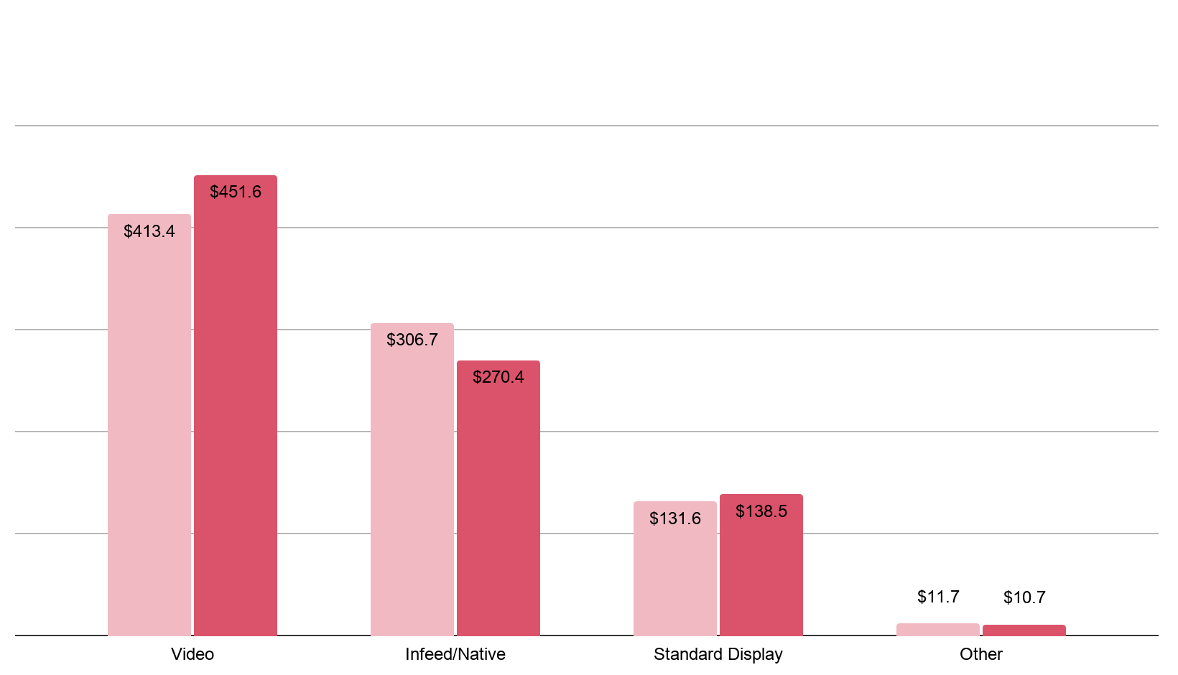
48%
Video Now Attracts More than Half of General Display Revenue
GENERAL ONLINE ADVERTISING EXPENDITURE SEPTEMBER QUARTER ($ MILLION)
Growth ($)
9%
12%
5%
9%
52%
34%
31%
17%
16%
1%
1%
Q3 2019
Q3 2020
Source; IAB Online Advertising Expenditure Report Compiled by PWC

Slide 21
Investment in digital advertising forecast to bounce back at 6.6% year on year for 2021
PWC ONLINE MEDIA AND ENTERTAINMENT REPORT 2020 - 2024 ONLINE ADVERTISING EXPENDITURE FORECAST ($ MILLION)
Total online advertising
2019-2024
CAGR 4.4%
Display CAGR 7.7%, driven by video at 19.6%
Source; PWC Online Media and Entertainment Outlook Report 2020 - 2024

Slide 22
For More research and resources can be found at
iabaustralia.com.au

