Slide 1
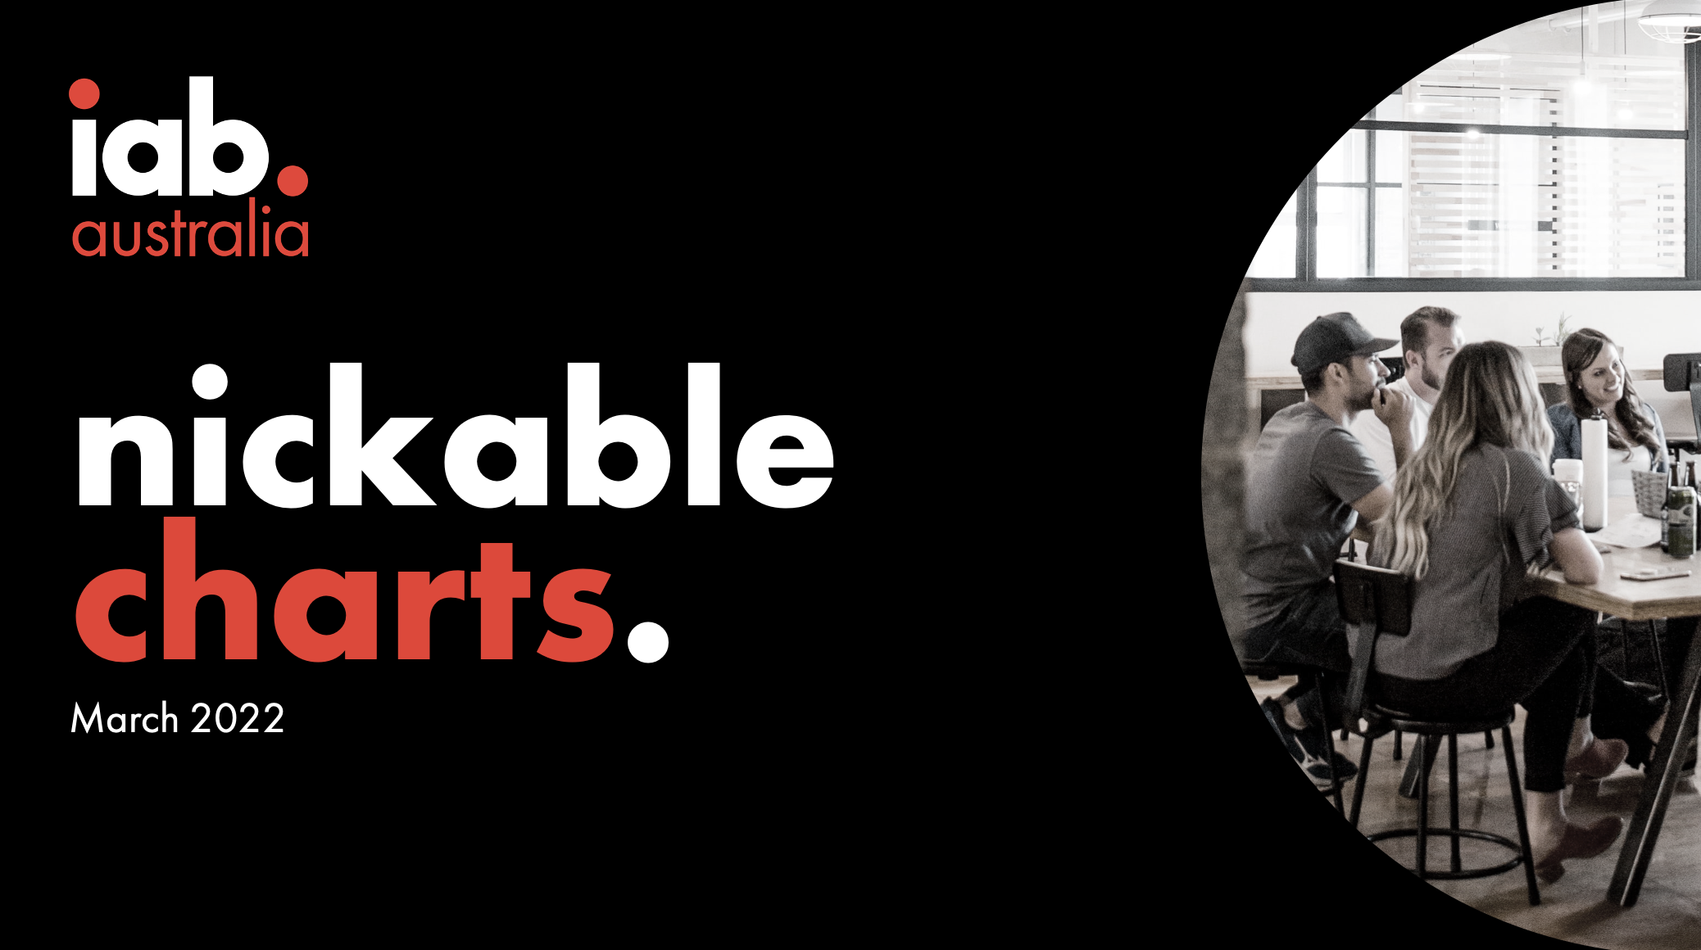

Slide 2
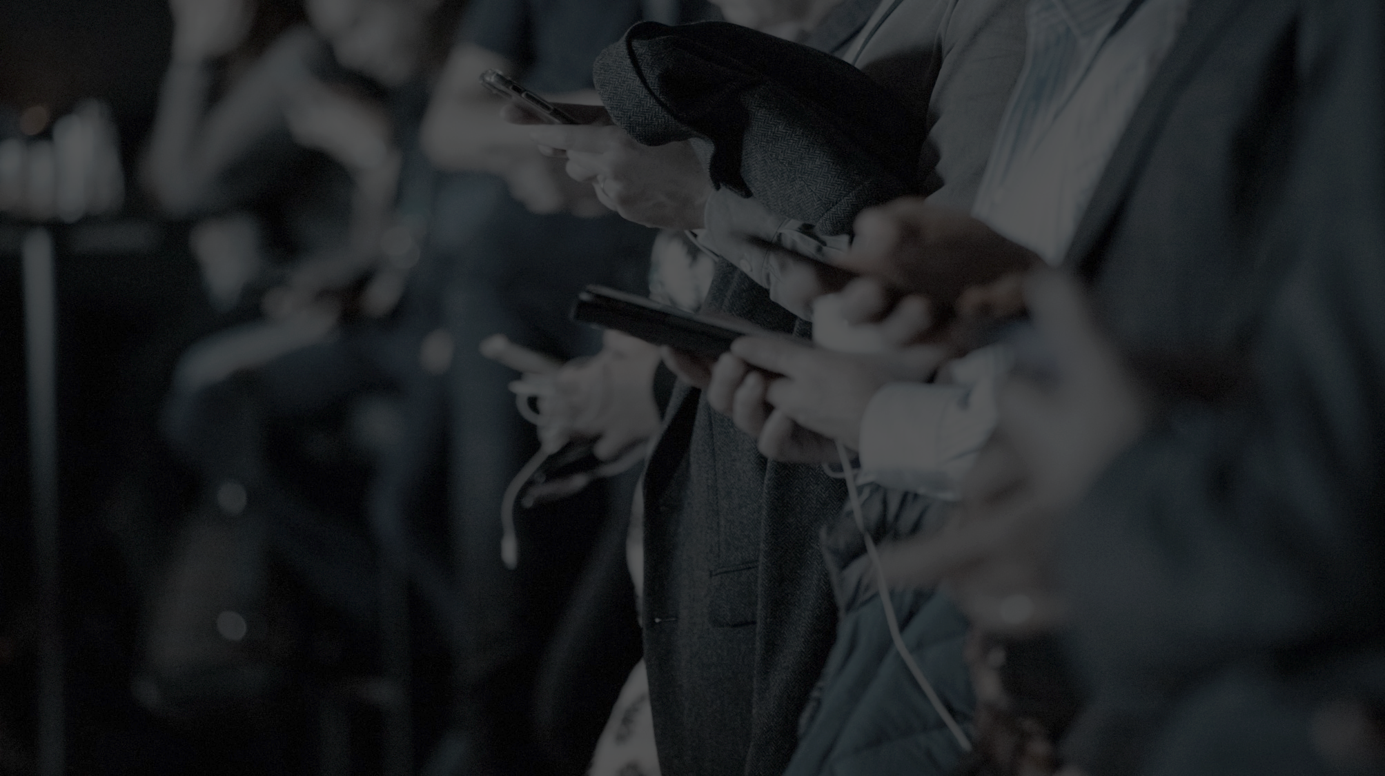
australian digital media consumption.
21 million australians (age 2+) were online this month
$13.0 billion digital ad market supports this content consumption
2
Source: Nielsen Digital Content Planning, November 2021, Text, Digital (C/M), People 2+, Unique Audience; IAB Australia Online Advertising Expenditure Report CY21 prepared by PWC

Slide 3
consumer trends charts.

Slide 4
australians continue to access online content daily across multiple screens.
mobile
desktop
connected tv
tablet
18.1 million
8.8 million pc
3.7 million mac
8.6 million
4.7 million ipad
1.2 million android
average 6.6 video capable screens per household
4
Source; IAB Australia Nielsen Digital Enumeration Study September 2021- November 2021 quarter ages 14+ n=3000 per quarter;
ThinkTV TV Fact Pack Tech Penetration Jan-Jun2021

Slide 5
connected tv audience continues to grow.
view internet content on a connected tv daily
11.9 million Australians
18% YOY increase
have ever viewed Internet content on a TV screen,
8.6 million view daily.
5
Source; IAB Australia Nielsen Digital Enumeration Study September 2021- November 2021 quarter ages 14+ n=3000 per quarter
Source; IAB Australia Nielsen Digital Enumeration Study March 2021 – May 2021 quarter ages 14+ n=3000 per quarter

Slide 6
a quarter of australians aged 14+ have a smart speaker in the home.
% with a smart speaker at home
5.4 million Australians own a smart speaker.
Ownership has increased 32% over the last year.
Frequency of use is also increasing, 63% of those with a smart speaker at home use it weekly, up 39% over the last year.
6
Source; IAB Australia Nielsen Digital Enumeration Study September 2021- November 2021 quarter ages 14+ n=3000 per quarter

Slide 7
the pandemic has driven a digital content consumption boom over the last two years.
total time for total audience of top 150 tagged digital content brands
time spent peaked in August 2021 with delta outbreak lockdowns and end of the Tokyo Olympics
total time spent in 2021 on top 150 brands up 16% on 2019
time spent in Jan/Feb 2022 tracking slightly above 2021
7
Source; Nielsen Digital Media Ratings Volumetrics Monthly Tagged, January 2019 – February 2022, P2+, Digital c/m, Text, Top 150 brands, Total Time Spent
Notes:
January 2021 up 10% year on year; February 2021 -3% year on year.

Slide 8
covid lockdowns driving digital news consumption lift over last two years.
total time spent for total audience of tagged news brands
Total time spent on digital news content in 2021 up 42% on 2019.
time spent Jan/Feb 2022 tracking slightly above 2021 driven by Omicron outbreak and Russia-Ukraine war
8
Source; Nielsen Digital Media Ratings Volumetrics Monthly Tagged, January 2019 – February 2022, P2+, Digital c/m, Text, Current Events and Global News sub-category, Total Time Spent
Notes:
January 2021 up 10% year on year; February 2021 -3% year on year.

Slide 9
market growth lifted interest in real estate over the second half of 2020 and into 2021.
total time spent for total audience of tagged real estate brands
Time spent was at its highest in January 2021, up 35% year on year
Activity lifted again after lockdown restrictions were eased in the seasonally high month of October 2021.
total time spent on real estate content in 2021 up 8% YoY and 38% on 2019.
9
Source; Nielsen Digital Media Ratings Volumetrics Monthly Tagged, January 2019 – February 2022, P2+, Digital c/m, Text, Real Estate sub-category, Total Time Spent
Notes:
January 2021 up 10% year on year; February 2021 -3% year on year.

Slide 10
younger audiences spend the greatest time streaming online video content.
av time spent per person per month streaming video on smartphone, tablet, desktop
17.4 million
Australian adults (18+) stream video online spending on average 50 hours streaming in a month.
10
Source; Nielsen Digital Content Planning, November 2021, Video, Digital (C/M), Computer, Mobile, P18+, Av time pp

Slide 11
76% of online shoppers buy online at least once a month.
buying frequency for online shoppers
70%
buy retail online (non-grocery) every month
40%
buy groceries online every month
Source; IAB Australia and Pureprofile Australian Ecommerce Report September 2021 Q - How often do you shop online? (n=1,000)

Slide 12
expenditure charts.

Slide 13
australian consumer online retail spend has grown 20% year on year for CY21.
NAB online retail sales and ABS retail sales
Australians spent $52.93 billion on online retail in 2021, around 14.4% of the total retail trade estimate.
Source; NAB Online Retail Sales Index December 2021

Slide 14
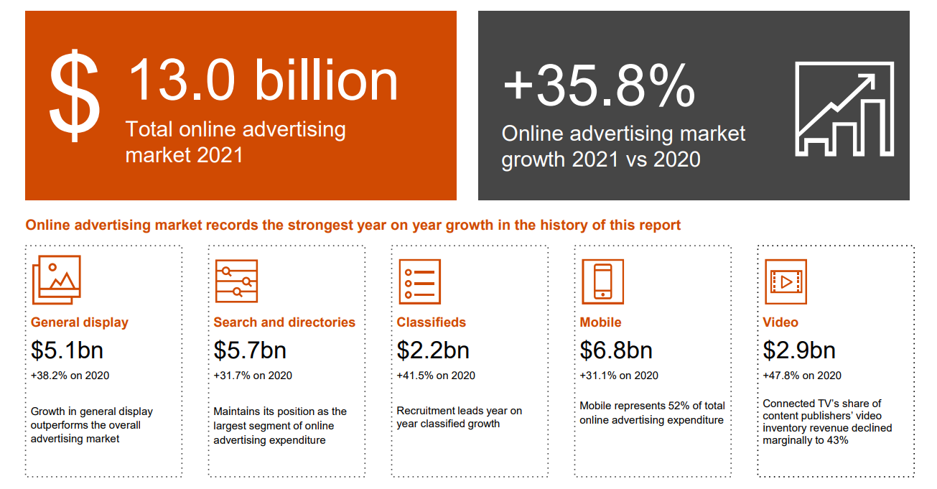
online advertising expenditure CY21.
Source; IAB Australian Online Advertising Expenditure Report Compiled by PwC calendar year and quarter ended 31 December 2021

Slide 15
quarterly online advertising expenditure.
quarterly online advertising expenditure
All categories have recorded significant growth in 2021
Source; IAB Australian Online Advertising Expenditure Report Compiled by PwC calendar year and quarter ended 31 December 2021

Slide 16
effectiveness charts.

Slide 17
all digital formats can help build brands.
the digital brand effect
Kantar’s Digital Brand Effect Report with the IAB found digital advertising is effective at delivering brand impact and has a marketing role beyond that of short-term sales
average campaign impact per person reached
Source; Kantar IAB Digital Brand Effect Report 2019

Slide 18
digital retains brand impact.
the digital brand effect
Kantar’s Digital Brand Effect Report with the IAB found that the brand impact of digital campaign exposure is retained well after the campaign ends and this retention is comparable to offline media channels.
% retained brand impact after advertising ends
8 weeks after flighting, digital media retains over 20% of original brand impact
Source; Kantar IAB Digital Brand Effect Report 2019

Slide 19
more research and resources
www.iabaustralia.com.au
T (02) 9211 2738
E iabaustralia@iabaustralia.com.au
A Suite 101, Level 1, 54 Foveaux St, Surry Hills, 2010
iabaustralia.com.au

