Slide 2
australian digital media consumption
21 million australians (age 14+) were online this month, each spending on average 107 hours on a PC/laptop, smartphone, or tablet device.
The Australian online ad market grew 9% year on year and supports the continued growth in consumer consumption across a wide variety of digital content and services.
$14.2 billion digital ad market supports this content consumption
Source: Ipsos iris Online Audience Measurement Service January 2023, Age 14+, PC/laptop/smartphone/tablet, online population; IAB Australia Online Advertising Expenditure Report (OAER) prepared by PwC Australia.

Slide 3
australians continue to access digital content and services across multiple screens
mobile
desktop
tablet
connected tv
19.2 million av 82 hours p/m
14.1 million av 32 hours p/m
3.6 million av 61 hours p/m
66% of population own a Smart TV in the household
Source: Ipsos iris Online Audience Measurement Service January 2023, Age 14+, PC/laptop/smartphone/tablet, online population audience and average time spent per person (hours)

Slide 4
overlap in digital device usage
overlap in devices for personal use
28%
of australians own a smartphone, computer and tablet for personal use and also have a smart TV in their household.
2.8
average number of any personally used devices across smartphone, computer, tablet (excl Smart TV).
Smartphone
95%
79%
44%
38%
Computer
80%
56%
28%
33%
45%
Tablet
28%
57%
33%
66%
Smart TV
Source: Ipsos iris Establishment Survey, December 2022, N=14,593 P14+

Slide 5
outside of the main devices, gaming consoles and streaming devices are the next most commonly owned.
other devices in the household
80%
of Australian households have at least one ‘other’ digital device outside of the main devices (smartphone, computer, tablet, smart TV).
Source: Ipsos iris Establishment Survey, December 2022, N=14,593 P14+

Slide 6
digital audience consumption by age across smartphone, PC/laptop and tablet.
Digital audience by age monthly audience 000s
digital time spent by age monthly time spent pp hours
Source: Ipsos iris Online Audience Measurement Service January 2023, Age 14+, PC/laptop/smartphone/tablet, online population audience and average time spent per person (hours)

Slide 7
australians consume a wide range of digital content and services.
audience of top 5 categories monthly audience 000s
share of time spent by category monthly total time spent
Source: Ipsos iris Online Audience Measurement Service January 2023, Age 14+, PC/laptop/smartphone/tablet, online population audience and share of total time top 5 categories

Slide 8
20.3 million australians consumed digital news content in January 2023, each spending on average 6 hours.
digital news audience by age monthly audience 000s
digital news time spent by age monthly time spent pp minutes
Source: Ipsos iris Online Audience Measurement Service January 2023, Age 14+, PC/laptop/smartphone/tablet, news category total audience and average time spent per person (minutes)

Slide 9
20.6 million australians visited an online retailer in January 2023, each spending on average nearly 5 hours.
Ipsos iris top 10 online retailers January 2023 audience 000s (age 14+)
NAB estimates that in the 12 months to January 2023, Australians spent $53.31 billion on online retail, a level that is around 13% of the total retail trade estimate and a contraction (-1.4%) relative to the 12 months to January 2022.
Source: Ipsos iris Online Audience Measurement Service January 2023, Age 14+, PC/laptop/smartphone/tablet, retail and commerce category total audience, av time pp (hours) and top 10 Brand Group (audience 000s);
NAB Online Retail Sales Index January 2023 and December 2022, Series 8501, Australian Bureau of Statistics.

Slide 10
australians consume a range of digital video and audio content types.
consumption of digital video and audio content in past 7 days
85%
watched any video online in past 7 days.
69%
Listened to any online audio in past 7 days.
Source: Ipsos iris Establishment Survey, December 2022, N=14,593 P14+

Slide 11
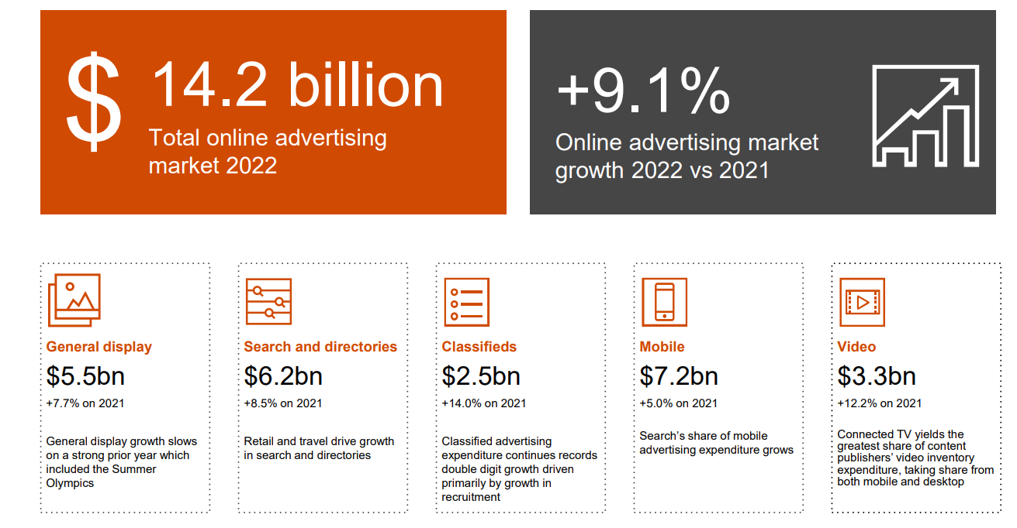
online advertising expenditure market CY 2022
Source: IAB Australia Online Advertising Expenditure Report (OAER) prepared by PwC Australia.

Slide 12
online advertising expenditure market trend
online advertising expenditure by quarter $ million and year on year change
9.1%
$14.2 billion online ad market CY22.
9% growth year on year.
48% growth from 2020.
36.0%
5.6%
2.5%
11.6%
7.0%
Source: IAB Australia Online Advertising Expenditure Report (OAER) prepared by PwC Australia. Note: General display revenues of Guardian News and Media Limited, Daily Mail Australia, Snapchat and Spotify were introduced from 2018. Growth trends will be impacted by the addition of these contributors.

Slide 13
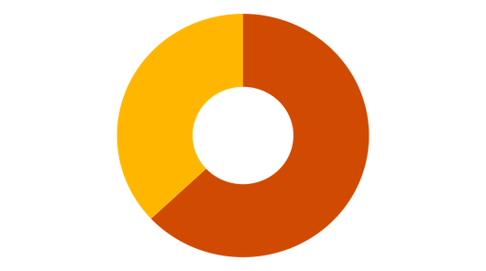
The total Australian online audio advertising market in CY22 was
$221.2m
representing
4.0%
37%
63%
of total CY22 general display advertising expenditure
63%
$82.5m
Podcast advertising expenditure
$138.7m
Streaming advertising expenditure
Source: IAB Australia Online Advertising Expenditure Report (OAER) prepared by PwC Australia.
Notes:
Gai to talk to AU results.
The numbers include all CRA members, publishers with significant podcasting businesses like The Guardian, News Corp
Reference global comparisons – our colleagues in IAB UK and US haven’t released their 2022 numbers yet but for comparison in 2021 the US market share of display was 4.6% and UK was 2.2% - so the US is slightly ahead in terms of share but with the growth in the digital audio market I am imaging the UK numbers for 2022 will be close to our local share at 4%.
The State of the Nation research that Natalie will share shortly will identify some of the investment trends, barriers and opportunities that are top of mind for buyers as we move through 2023.
The growth in the digital audio market is underpinned by consumer engagement with the vast array of ad supported audio content. I will hand over to Ford to discuss……..

Slide 14
sources.
IAB Australia Online Advertising Expenditure Report prepared by PWC
The Interactive Advertising Bureau (IAB) has engaged PricewaterhouseCoopers (PwC) to establish a comprehensive standard for measuring online advertising expenditures. The IAB OAER is an ongoing IAB mission to provide an accurate barometer of online advertising expenditure growth. To achieve differentiation from existing estimates and accomplish industry-wide acceptance, key aspects of the OAER include:
Obtaining data directly from companies earning online advertising expenditures
Making the OAER as inclusive as possible, encompassing all forms of Internet/online advertising, including web sites, mobile and video advertising including those sold programmatically
Ensuring and maintaining a confidential process, only releasing aggregate data
Performing “spot checks” of data submitted by participants to increase the overall integrity of the data.
The online advertising expenditure measured by the OAER is based on amounts charged to the advertiser before any reductions for agency rebates. Therefore, the amount reported is the gross commissionable advertising revenue
Ipsos iris, IAB endorsed digital audience measurement currency
Ipsos iris is the IAB Australia endorsed digital content measurement system for the planning, buying, and reporting of digital audiences in Australia.
Ipsos iris is an inclusive, standardised currency providing a level playing field for comparison of digital audience reach and characteristics, along with other insights about Australians aged 14+ who access the wide variety of digital content and services on Smartphone, PC/Laptop and Tablet devices.
Ipsos iris brings a hybrid methodology combining metered data from a high quality, nationally representative, single-source passive panel with site-centric census measurement.
Ipsos conducts an establishment survey of 12,000 Australians aged 14 and over per annum to capture their digital device ownership and usage at both a household and personal level. The survey is designed to create a digital universe on which to project online audiences and to provide panel recruitment targets covering demographics and device type ownership and usage.
Data from the Ipsos iris digital currency and from the establishment survey is included in these nickable charts.

Slide 15
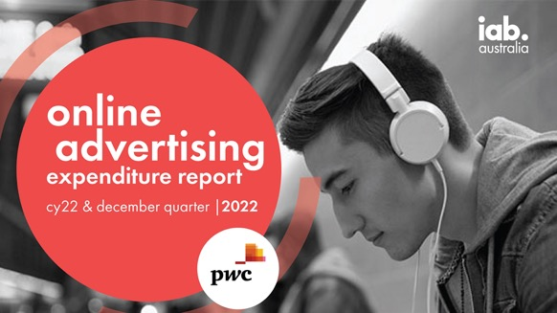
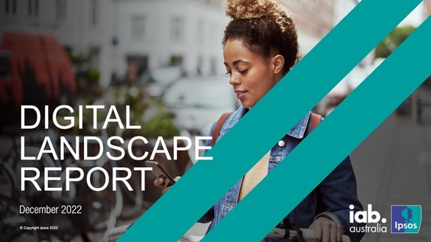
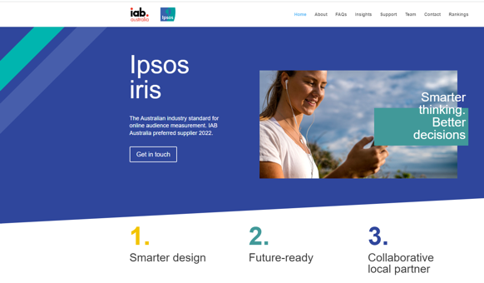
other resources.
IAB Australia online advertising expenditure report
Ipsos iris Digital Landscape Report
Ipsos iris insights

