Slide 1
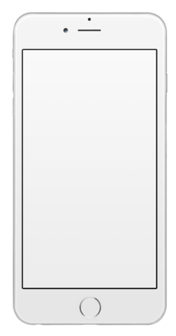
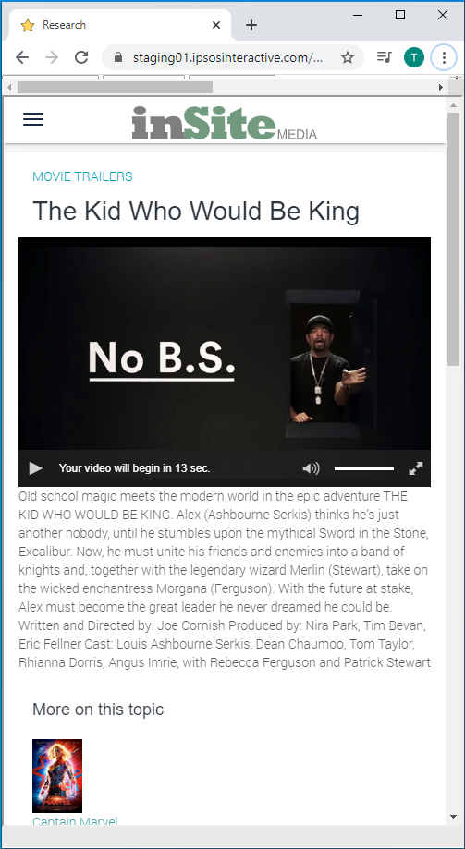
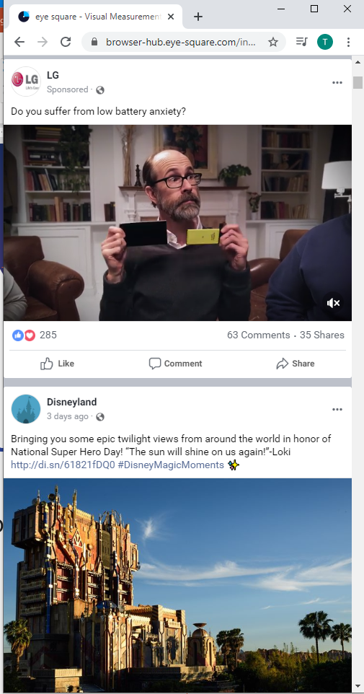
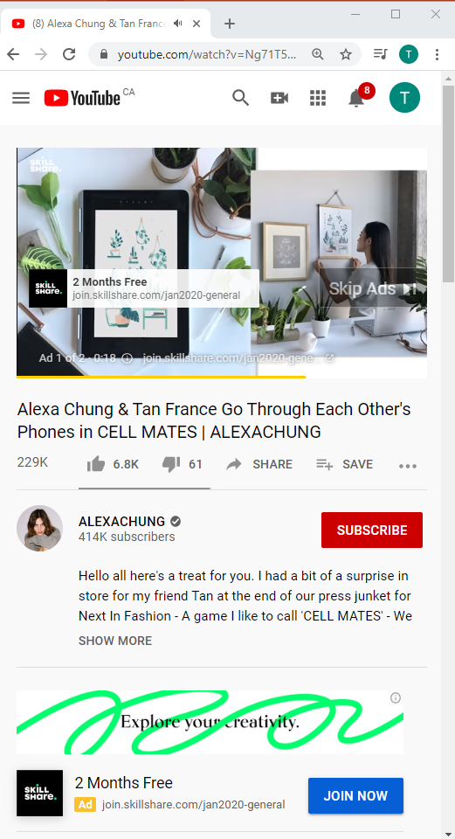
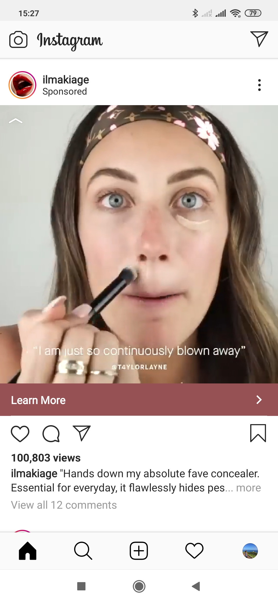
respect context or fail

Slide 2

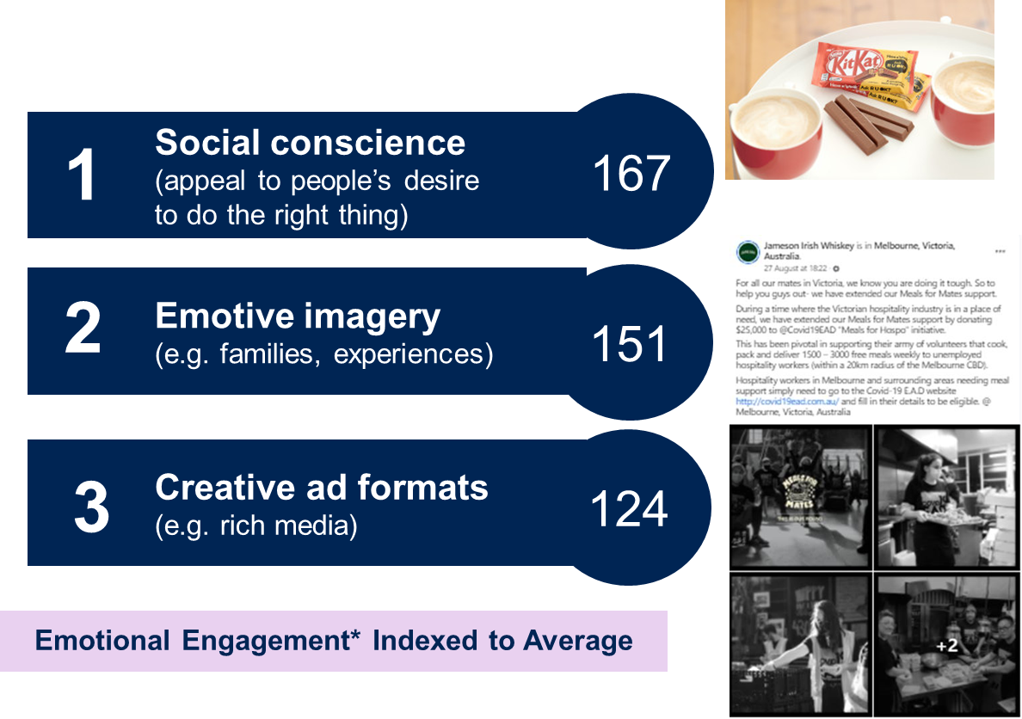

We believe that the best communications connect brands with people on a personal level
Emotional Engagement* effect on purchase intent
31%
lift
81%
lift
*Emotional Engagement based on diagnostic ad ratings

Slide 3
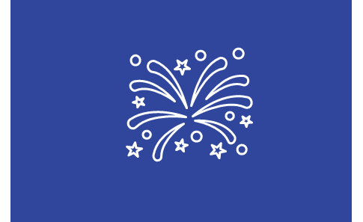
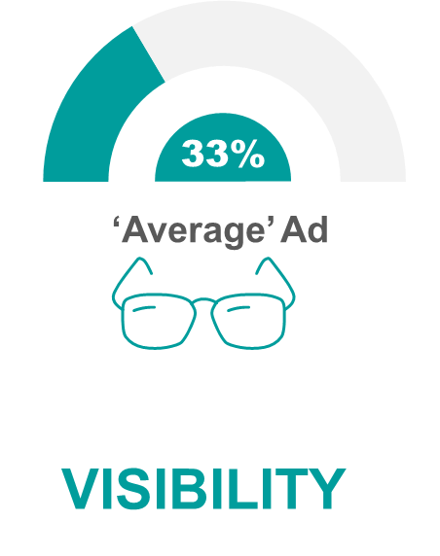
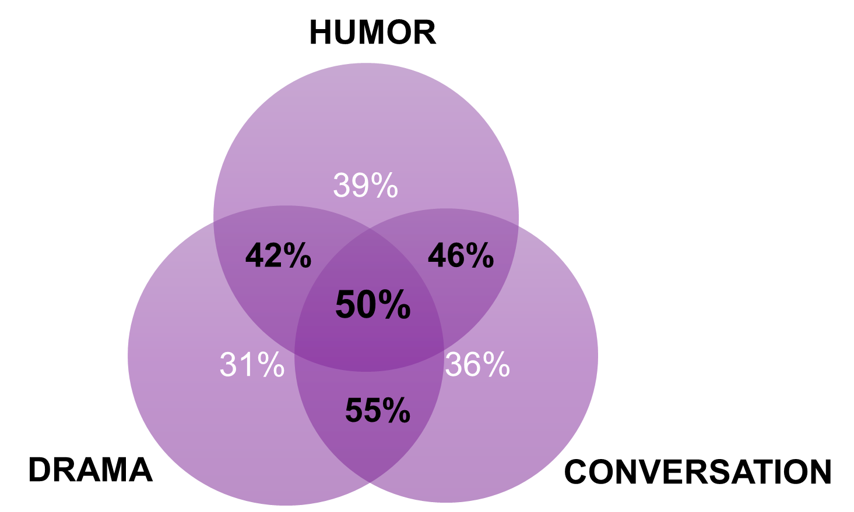
Be a content creator, not an advertiser
Entertaining users can boost the chance the creative is encoded in memory and has the potential to influence mental networks and end choice
50%
Archetype A
Drama
Humor
Conversation

Slide 4

Budget Direct – Bad Dog
Notes:
In the interest of time I’m not going to play this ad, but will provide a link in the pack if you haven’t seen it, but here’s a recent example of a piece of creative for budget direct that definitely combines these elements.

Slide 5

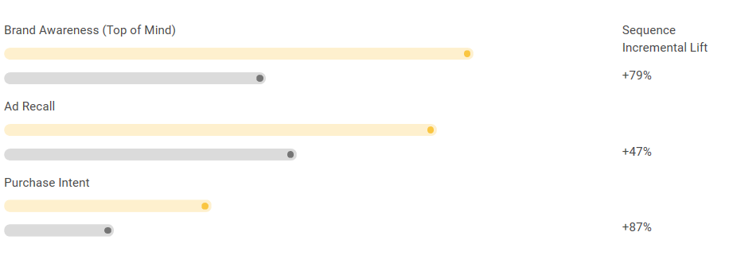
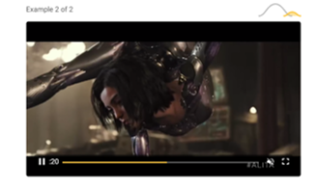


Sequence your story
Tell different chapters across multiple creative rather than trying a “one shot” approach
Source: https://www.thinkwithgoogle.com/feature/youtube-ad-sequencing-and-ad-recall/five-sequences/direct-shot?lang=en_US

Slide 6
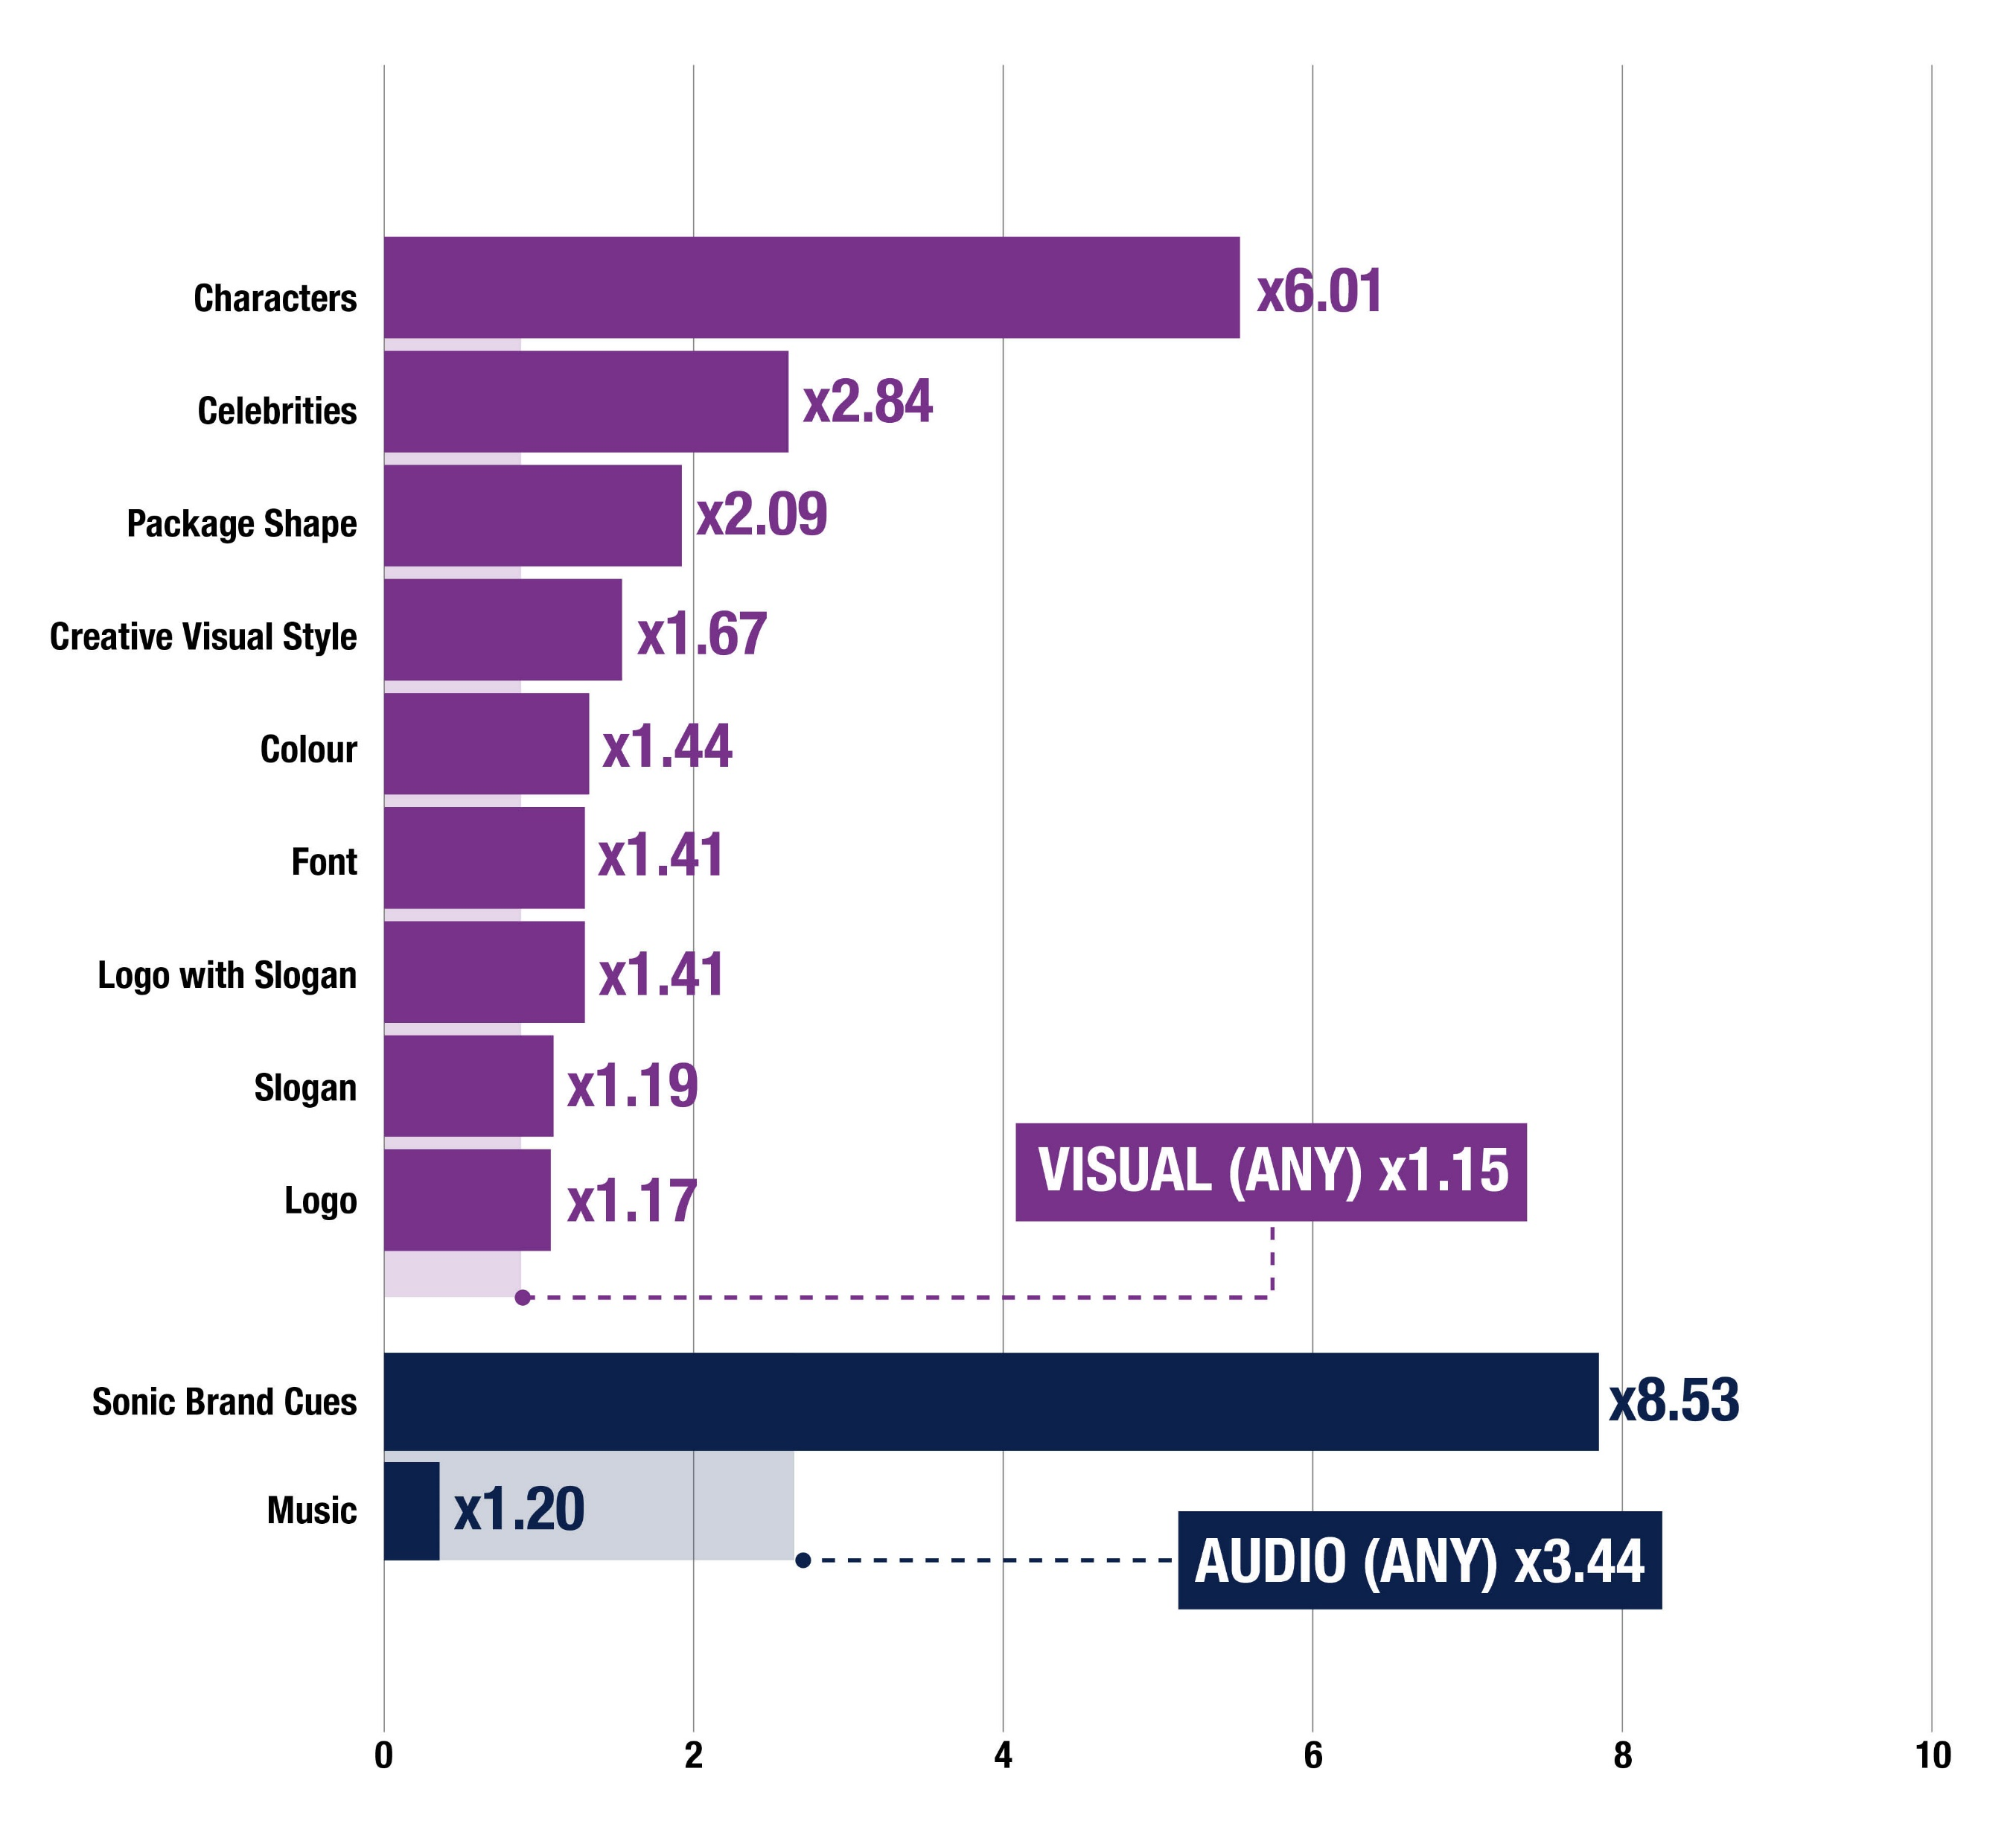
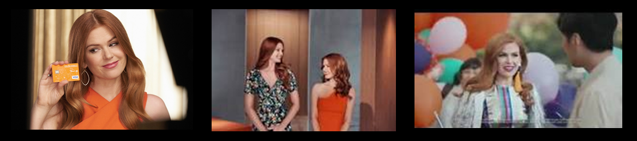
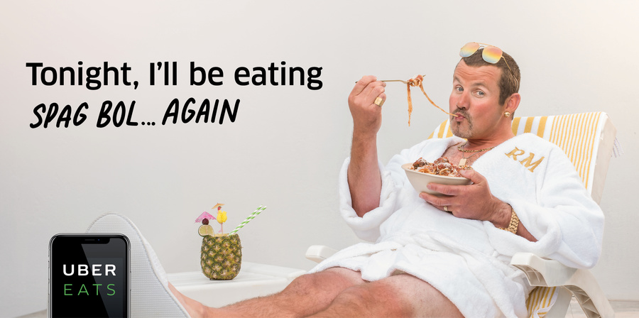


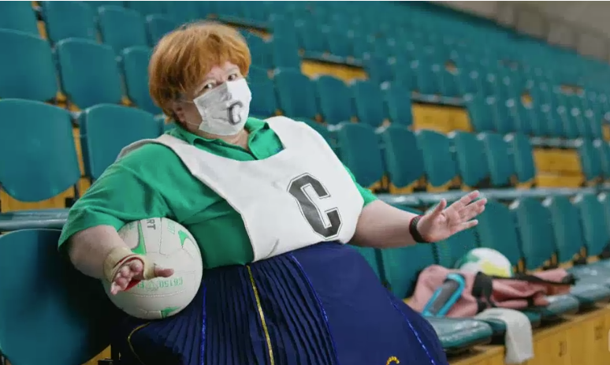
Use the power of you
Leverage brand assets that are distinctive to you when developing digital content
Source: Ipsos Creative Excellence “The Power of You” Paper, here)

Slide 7
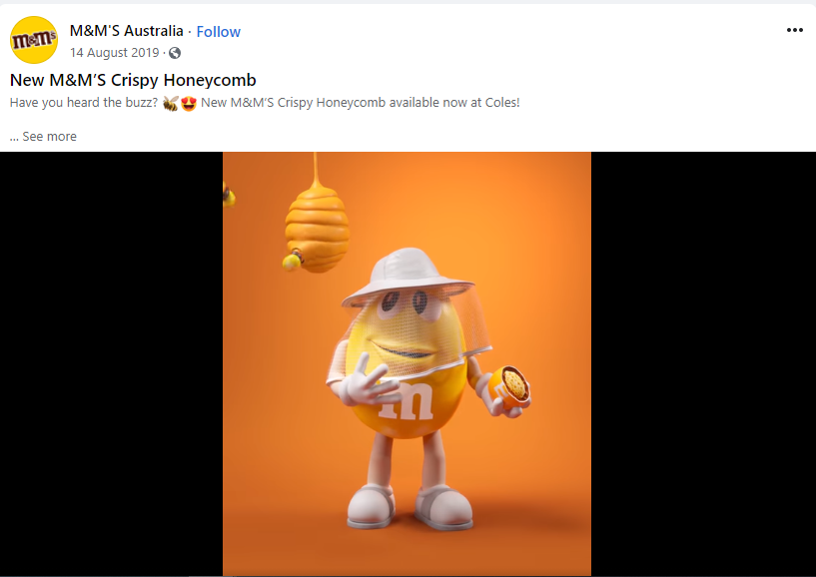
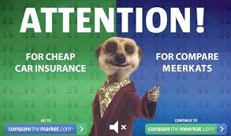
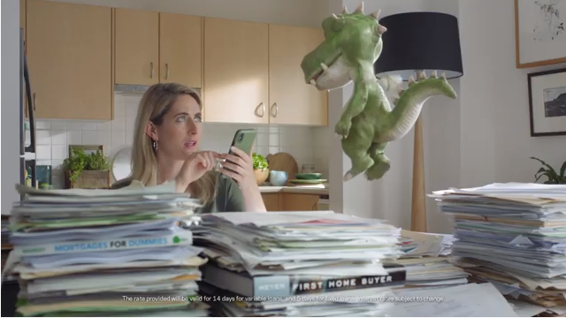
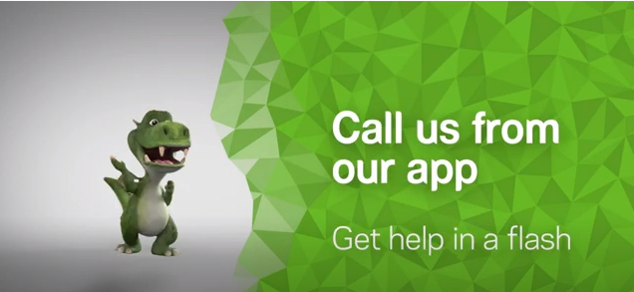


Use the power of you
Leverage brand assets that are distinctive to you when developing digital content
Source: Ipsos Creative Excellence “The Power of You” Paper, here)

Slide 8

Respect context or fail
Focus on emotional brand building
Be a content creator, not an advertiser
Sequence your story, don’t try and tell it all at once
Use the Power of You, and “brand without branding”
Notes:
So to

