Slide 1
The Path to ‘Cracking’ and Effective Creative
Sam Walters
Notes:
Thank you Gai. First things first when attempting to answer the question of how do we deliver great creative I want to emphasise that there is no absolute magic formula to develop extraordinary creative.
Great campaigns require great talent and effort from creative professionals. However, saying that, the best practice rules that guide that journey to effective ads need not be difficult.
I want to take the next few minutes giving you a brief overview of those guidelines and share a few examples of the best digital ads we’ve seen over the past year.

Slide 2
Compared to before the pandemic began
17%
are using social media more
…..
21%
20%
16%
are using online media more
…..
24%
Notes:
Before we move on to the guidelines I did just want to share a recent stat from our Covid19 Barometer that we’ve been running on a monthly basis since March, asking a range of attitudes of consumers during the crisis.
It probably comes as no surprise to any of you that we have seen a significant uptick in the use of social media platforms and online media since the start of the year, but it does just continue the trend for digital to just get bigger and bigger as a channel and the rewards for getting creative right in this environment are huge.

Slide 3
Three simple core attributes help to drive great digital creative
1
+
2
=
3
Driving branded engagement
Conveying meaningfully different associations
Creating short and long term predisposition
Is it enjoyed?
Is it involving?
Will it generate emotion?
Will the brand be remembered?
Does the ad communicate the desired message on strategy?
Fundamentally will the ad drive persuasion towards the brand?
Will it impact longer term equity?
Notes:
3)So back to those guidelines. Whilst there’s lots of intricacies around them and we could talk about each for hours the good news is that they can really be boiled down to just 3 main buckets.
Driving Branded Engagement is all about your ad being enjoyable and/or highly engaging i.e. something that stands out and makes it distinctive. And crucially it has to be linked to the brand.
Conveying meaningfully different associations is really about making sure that your ad delivers it’s intended message. A message that you should already know from prior research and strategy has potential to drive meaning and difference for your brand.
Whilst creating short and long term predisposition put simply is the ad needs to be able to drive short term persuasion for the advertised brand or longer term equity
So these might seem simple, but that’s exactly what we want, too often we over complicate advertising and if you look at those questions at the bottom that’s surely all we want from our ads.
In fact… the reality is that number 3 is nearly always a consequence of getting the first 2 right. So deliver 1 and 2… and you’re 90% of the way there!

Slide 4
Brand: Milka
Ad Name: Milka Christmas: Give to Those Who Give
The Most
Agency: Wieden + Kennedy, Amsterdam
Country: Germany
Brand: Google App
Ad Name: Search the Lyrics With Google
Agency: Ambilhati Indonesia
Country: Indonesia
Kantar Creative Effectiveness Awards
Consumers as judges
Short-term and long-term effectiveness
For more info - https://www.kantar.com/campaigns/creative-effective
Brand: Dulux
Ad Name: Let’s Colour Experiment: Escalator
Agency: Road381
Country: UK
Brand: Nesquik
Ad Name: Roommate Agency: Casanova//McCann Country: USA
Brand: Amstel 66
Ad Name: Why Amstel 66? Agency: Adam&Eve/DDB Country: UK
Brand: VANS
Ad Name: Waffleheads Agency: Internal Development Country: USA
Brand: Coca-Cola Ad Name: BottleFlip Agency: The Hive Country: Canada
Brand: Nintendo Switch
Ad Name: Nintendo Switch My Way
Agency: Leo Burnett
Country: USA
Brand: Grundig
Ad Name: Washing Machine with a Recycled Pet Tub - It Starts at Home
Agency: Mother London
Country: UK
Brand: BIC Gelocity Ad Name: Water 1508 Agency: Doner CX Country: USA
Notes:
So let’s see how those principles manifest in great creative in the real world, and I’m lucky to have on hand the absolute best of the best from 2019. Our Creative Effectiveness awards brought in the results from ad testing across the globe in 2019 and examined which had the highest potential for generating saliency and sales in the short term as well as driving long term equity.
Of course we’re not going to have a chance to share the full top 10 of digital ads (there is a link there if you did want to investigate further). But I will share two examples from the top 5 that role modeled the buckets I’ve just talked about. Whilst also demonstratrating a couple of additional observations that cropped up across the winners.

Slide 5
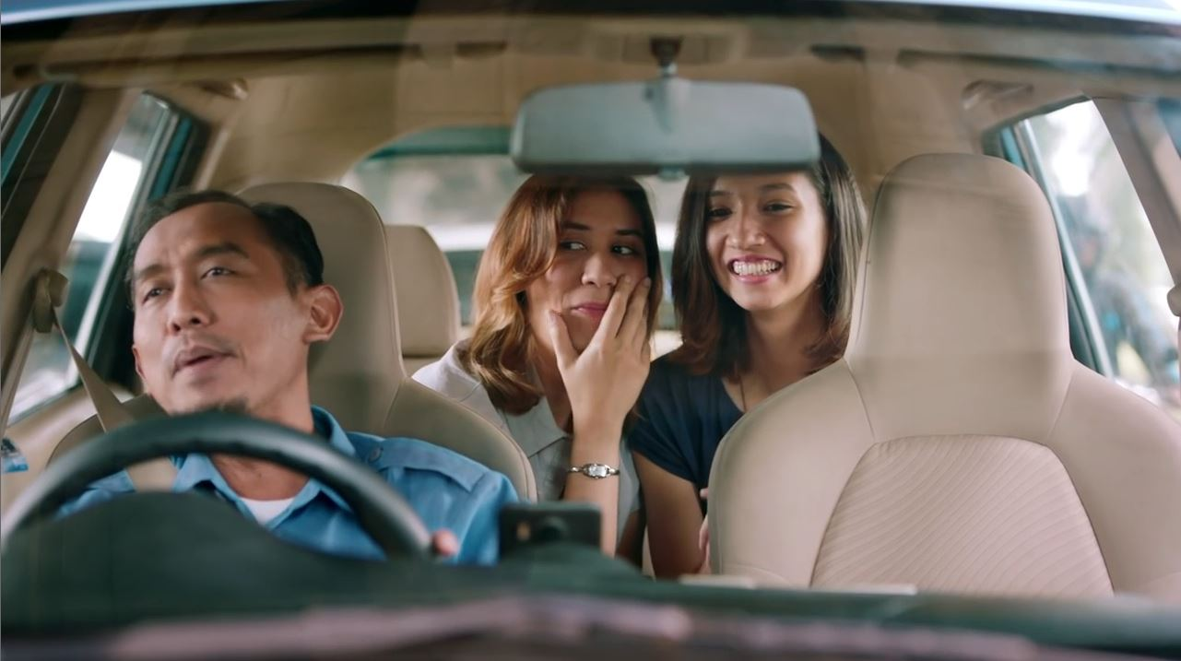
More uplifting and less sadvertising
Notes:
So the first ad I’m about to share absolutely delivers on branded engagement and delivering product message on strategy. But it also touches on an observation that was present across many of the digital winners, and that was that it delivered ‘a positive and uplifting tonality
There is really a lot to be said for raising a smile – Many of our top performing ads used humour to effectively create emotional engagement. Now Interestingly, this is in contrast with the trend we see more broadly, in which we see humour in advertising declining over time.

Slide 6
More uplifting and less sadvertising
Notes:
Just to back that up before I share the ad itself.
You can see from the chart on screen that ads that we have coded as being funny or light hearted used to make up approximately half of our cases but what we see in 2020 is that these types of ads have actually declined and now make up around a third of the our cases. It’s almost like the GFC in 2008-9 killed humour!
Which brings us on to the ad: Google’s ‘Search the Lyrics’ digital ad from Indonesia

Slide 7
Notes:
This ad engages, grabs attention and seamlessly integrates what is essentially a product demo into a fun narrative. So, there is a great deal to be said for raising a smile, and with it, people’s spirits, attention and brand predisposition.

Slide 8
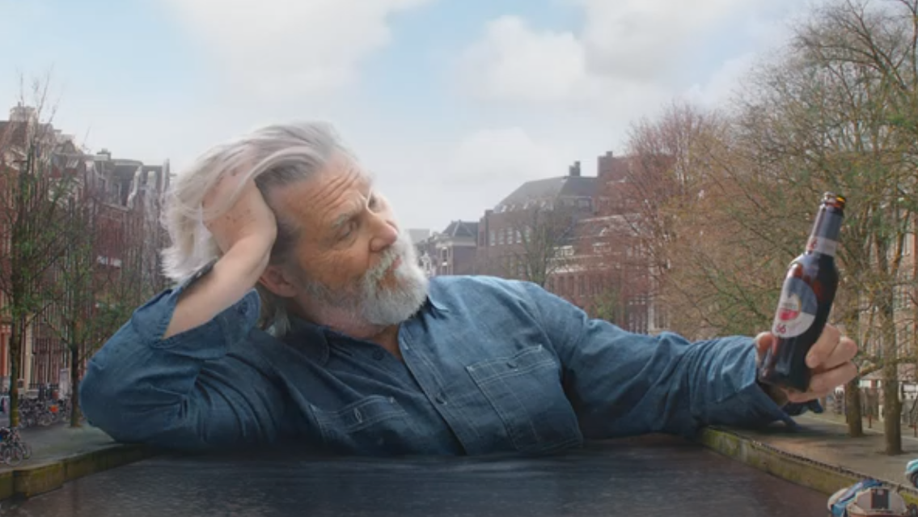
Short and sweet: short doesn’t have to mean short-term thinking
Notes:
The other observation I wanted to touch on was ad length. We know that shorter creative stands a better chance of being viewed within the digital context - many top performers are well under 15 seconds. But many advertisers have concerns that messages will be lost in such a short timespan
Amstel’s ‘Why Amstel 66?’ is a great example of how the message can be amplified by making it the focal point of a joke and — all delivered in under 10 seconds.

Slide 9
Notes:
This creative shows that short ads can also be creative and effective, and that short duration doesn’t have to mean short-term thinking in message delivery

Slide 10
There is no ‘one-size-fits-all’ approach to great content
Notes:
One of the main take outs for us in reviewing the winners, and as I alluded to at the start, was that there is no ‘one-size-fits-all’ approach that can be employed to achieve great content.
But there are a number of creative tactics together with these guidelines that can deliver a lasting impression in an effective way and help deliver cracking creative.

Slide 11
Notes:
And one final point. It would be remiss of me not to mention the IAB and Kantars ‘Digital Brand Effect’ report that we released last year. We’ll provide a link to the findings but this project ran some deep analysis looking into the contribution digital advertising makes to brand building and long-term impact. So another highly valuable resource for all of you interested in this area.
https://iabaustralia.com.au/resource/the-digital-brand-effect-oct-2019/

